Slide 1
Lending Club Case Study
Alok Bhatnagar
PGP ALML

Slide 2
Business Problem
I work for a consumer finance company which specialises in lending various types of loans to urban customers. When the company receives a loan application, the company has to make a decision for loan approval based on the applicant’s profile.
The company is the largest online loan marketplace, facilitating personal loans, business loans, and financing of medical procedures. Borrowers can easily access lower interest rate loans through a fast online interface.
The company wants to understand the driving factors (or driver variables) behind loan default, i.e. the variables which are strong indicators of default. The company can utilise this knowledge for its portfolio and risk assessment.

Slide 3
Analysis Approach
We’ll do the Exploratory Data Analysis based on the data provided to identify the correlation among the features.
Approach:
Data Cleansing
Univariate/Bivariate data analysis
Hypothesis generation

Slide 4
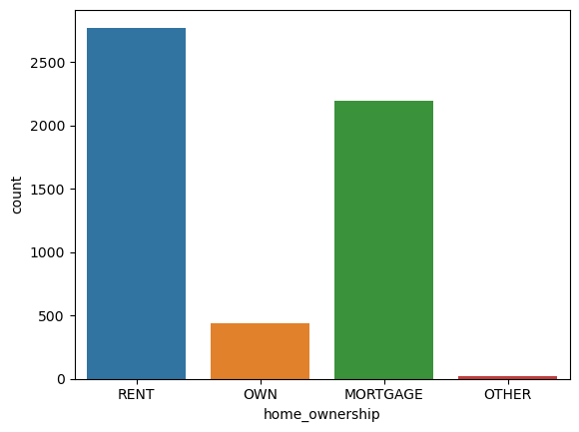
Major Findings
The above analysis concerning the charged-off loans for each variable suggests the following. There is a higher probability of defaulting when.
Applicants having house_ownership as 'RENT'

Slide 5
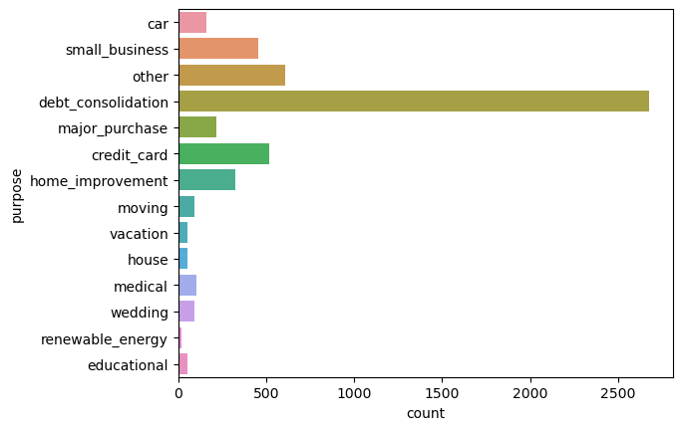
Major Findings
The above analysis concerning the charged-off loans for each variable suggests the following. There is a higher probability of defaulting when.
Purpose of loan is “Debt Consolidation”

Slide 6
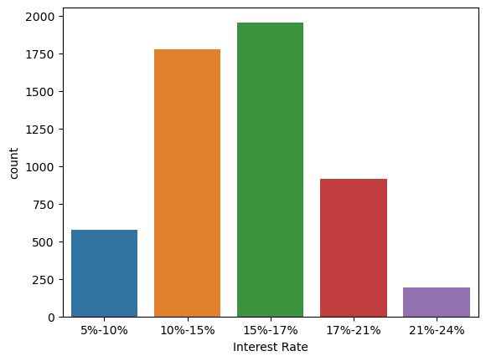
Major Findings
The above analysis concerning the charged-off loans for each variable suggests the following. There is a higher probability of defaulting when.
Interest rate is 15-17%

Slide 7
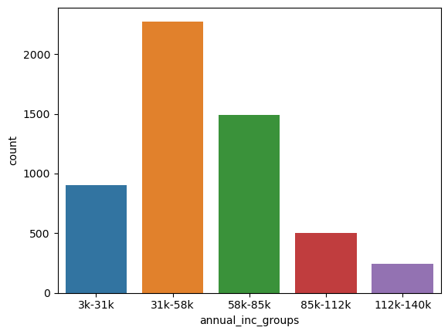
Major Findings
The above analysis concerning the charged-off loans for each variable suggests the following. There is a higher probability of defaulting when.
Annual income is between 31k to 58k

Slide 8
Major Findings
The above analysis concerning the charged-off loans for each variable suggests the following. There is a higher probability of defaulting when.
Applicants having house_ownership as 'RENT'
Applicants who use the loan to clear other debts
Applicants who receive interest at the rate of 15-17%
Applicants who have an income of range 31k - 58k
Applicants who have 20-37 open_acc
Applicants with employement length of 10
When funded amount by an investor is between 5000-10000
Loan amount is between 5k – 10k
Dti is between 12-18
When monthly instalments are between 140-275
Term of 36 months
When the loan status is Not verified
When the no of enquiries in the last 6 months is 0
When the number of derogatory public records is 0
When the purpose is 'debt_consolidation'

